Slide 1
The impact of hip fracture on an elderly person’s functional autonomy and independence
with a focus on participation in activities of daily living
Version 1. Created 27 February 2018
SC-EU-AMG162-00467
SC-AT-AMG162-00757 0421
(former: SC-AT-AMG162-00567 Sept 18)

Slide 2
Endorsement of this slide deck
This slide deck has been prepared with the following experts: Karsten Dreinhöfer, Paolo Falaschi, Kassim Javaid, Bente Langdahl, Ricardo Larrainzar-Garijo, Henrik Palm and Thierry Thomas
This slide deck was developed with support from Amgen
Medical writing support was provided by Oxford PharmaGenesis and was funded by Amgen

Slide 3
Contents
Hip fractures and ageing
Hip fractures and residence
Hip fractures and mobility
Hip fractures and activities of daily living
Hip fractures and other serious chronic diseases
Conclusions and next steps

Slide 4
Hip fractures accelerate functional decline in elderly people
Hip fractures and
ageing
Ageing
The number of people worldwide aged 60 years or over is projected to increase by 56% between 2015 and 2030 from 901 million to 1.4 billion¹
In 2014, the World Health Organization declared, “ageing well must be a global priority”²
Maintaining mobility, independence and the ability to reside in one’s own home are important as people age^{3–8}
Hip fractures
The number of hip fractures worldwide is expected to increase from 1.7 million in 1990 to 6.3 million by 2050^{9,10}
Hip fractures are associated with increased mortality in elderly people^{11–14}
However, 42–86% of elderly people are alive 1 year after a hip fracture¹⁴
Hip fractures have a significant impact on the functional autonomy and independence of elderly people^{15,16}
They result in more functional decline than would be expected from normal ageing^{15,17–20}
Notes:
In particular, retaining functional autonomy and independence is a concern for elderly people.^{1–6} Heathcote G. (2000)⁴ describes a comparative qualitative study undertaken in Italy and the United Kingdom that explored elderly people’s perceptions of old age and ageing, and established a ranking of factors that contribute towards the maintenance or loss of autonomy. The results were collated with the expressed views of practitioners and other people working directly with elderly people in a range of settings in eight different European Union countries.⁵ The paper reported some quotations from elderly people; these included:⁴
“…loss of health limits autonomy…”
“…to stay autonomous, movement is important…”
“…autonomy means retaining control over my life…”
“…it is better to die than lose one’s autonomy…”
One of the ways in which poor health reduces quality of life is through its effect on a person’s ability to be independent.⁷
Elderly people should therefore be supported in maintaining their independence and well-being.^{1,8}
In this presentation, the term ‘autonomy’ is not used with reference to the medical ethics principle,⁹ but with reference to the concept of being able to maintain independence in activities of daily living into old age.
References
World Health Organization. 2015. Available from: http://apps.who.int/iris/bitstream/10665/186463/1/9789240694811_eng.pdf?ua=1 (Accessed January 2018).
Hillcoat-Nallétamby S. J Gerontol 2014;69:419–30.
Lowry KA et al. Aging Dis 2012;3:5–15.
Heathcote G. Health Educ Res 2000;15:13–24.
Bowling A et al. BMJ 2005;331:1458–61.
Fry PS. In J Aging Hum Dev 2000;50:361–83.
Grewal I et al. Soc Sci Med 2006;62:1891–901.
National Institute for Health and Care Excellence. 2015. Available from: https://www.nice.org.uk/guidance/ng32 (Accessed January 2018).
Gillon R. BMJ 1994;309:184–8.
Slide references
World Health Organization. 2015. Available from: http://www.un.org/en/development/desa/population/publications/pdf/ageing/WPA2015_Report.pdf (Accessed January 2018).
World Health Organization. 2014. Available from: http://www.who.int/mediacentre/news/releases/2014/lancet-ageing-series/en/ (Accessed January 2018).
World Health Organization. 2015. Available from: http://apps.who.int/iris/bitstream/10665/186463/1/9789240694811_eng.pdf?ua=1 (Accessed January 2018).
Hillcoat-Nallétamby S. J Gerontol 2014;69:419–30.
Grewal I et al. Soc Sci Med 2006;62:1891–901.
Bowling A et al. BMJ 2005;331:1458–61.
Fry PS. Int J Aging Hum Dev 2000;50:361–83.
Heathcote G. Health Educ Res 2000;15:13–24.
Filipov O et al. J IMAB 2014;20:516–18.
Marks R et al. Int J Gen Med 2010;3:1–17.
Haentjens P et al. Ann Intern Med 2010;152:380–90.
Bliuc D et al. JAMA 2009;301:513–21.
Trombetti A et al. Osteoporos Int 2002;13:731–7.
Schnell S et al. Geriatr Orthop Surg Rehabil 2010;1:6–14.
Dyer SM et al. BMC Geriatr 2016;16:158.
Kerr C et al. Osteoporos Int 2017; 28:1597–607.
Fischer S et al. Osteoporos Int 2017;28:2843–51.
Lunenfeld B et al. Best Pract Res Clin Obstet Gynaecol 2013;27:643–59.
Lowry KA et al. Aging Dis 2012;3:5–15.
Boonen S et al. Osteoporos Int 2004;15:87–94.

Slide 5
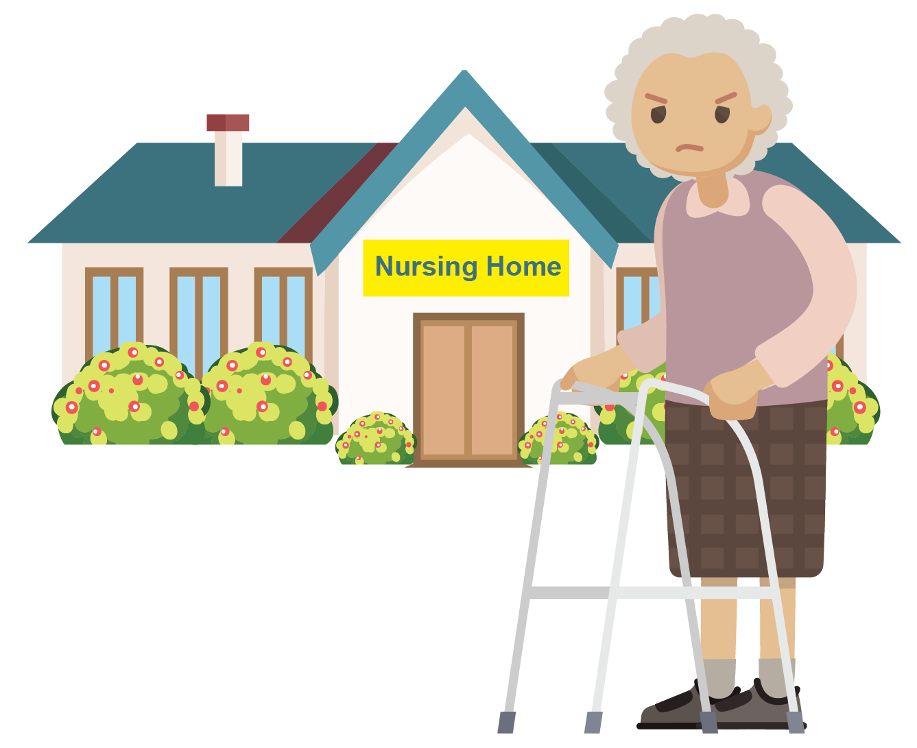
Elizabeth’s story
Hip fractures and
ageing
Elizabeth has been forced to relocate to a nursing home following her hip fracture and she has lost a lot of her functional autonomy
Elizabeth is a 75-year-old woman who fractured her hip following a fall
Before her fall, Elizabeth lived in her own home, was fully independent and cared for herself. She was also active in her local community
Elizabeth is now unable to live alone because she requires help with most tasks
She now lives in a nursing home near to her family but away from her friends
Elizabeth requires a walking frame and is unable to walk for long distances
She is unable to shower or dress without help from her carer
Elizabeth is unable to pursue gardening or community work, which she previously enjoyed
She has become anxious and is easily upset
Notes:
In a survey reported by Salkeld G et al. (2000)¹ that was embedded in a randomised controlled trial, respondents were asked to rate their own health by using the 5-dimension EuroQoL questionnaire (EQ-5D), and then to rate three health states (fear of falling, a ‘good’ hip fracture and a ‘bad’ hip fracture) by using a time trade-off technique. A ‘bad’ hip fracture results in dependency and admission to a nursing home, as described here for Elizabeth, and a ‘good’ hip fracture results in maintaining semi-independent living in the community, as described for Jean on the next slide.¹
Reference
Salkeld G et al. BMJ 2000;320:341–6.

Slide 6
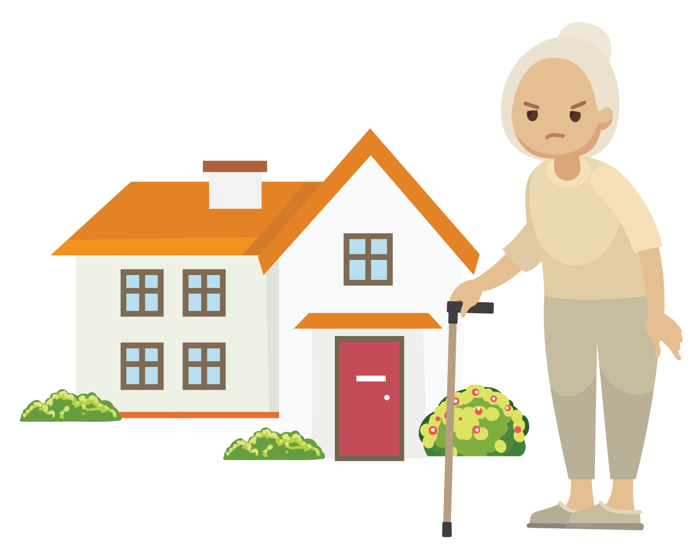
Jean’s story
Hip fractures and
ageing
Jean has been able to remain in her own home following her hip fracture, but like Elizabeth, she has lost some of her functional autonomy
Jean is a 75-year-old woman who fractured her hip following a fall
She lives in her own home
Before her fall, Jean was fully independent and cared for herself. She previously went into town with her friends and sister. Jean previously went swimming on a regular basis and occasionally cared for her grandchildren
She now walks with a stick and is finding it more difficult to do routine tasks
Jean can no longer manage the housework on her own
She also needs help with shopping and no longer feels confident to shop on her own
Jean can only prepare simple meals and misses being able to bake for her friends
She finds it too painful and tiring to be out of the house for long periods
Jean has feelings of frustration and anger
Notes:
In a survey reported by Salkeld G et al. (2000)¹ that was embedded in a randomised controlled trial, respondents were asked to rate their own health by using the 5-dimension EuroQoL questionnaire (EQ-5D), and then to rate three health states (fear of falling, a ‘good’ hip fracture and a ‘bad’ hip fracture) by using a time trade-off technique. A ‘bad’ hip fracture results in dependency and admission to a nursing home, as described for Elizabeth on the previous slide, and a ‘good’ hip fracture results in maintaining semi-independent living in the community, as described here for Jean.¹
Reference
Salkeld G et al. BMJ 2000;320:341–6.

Slide 7
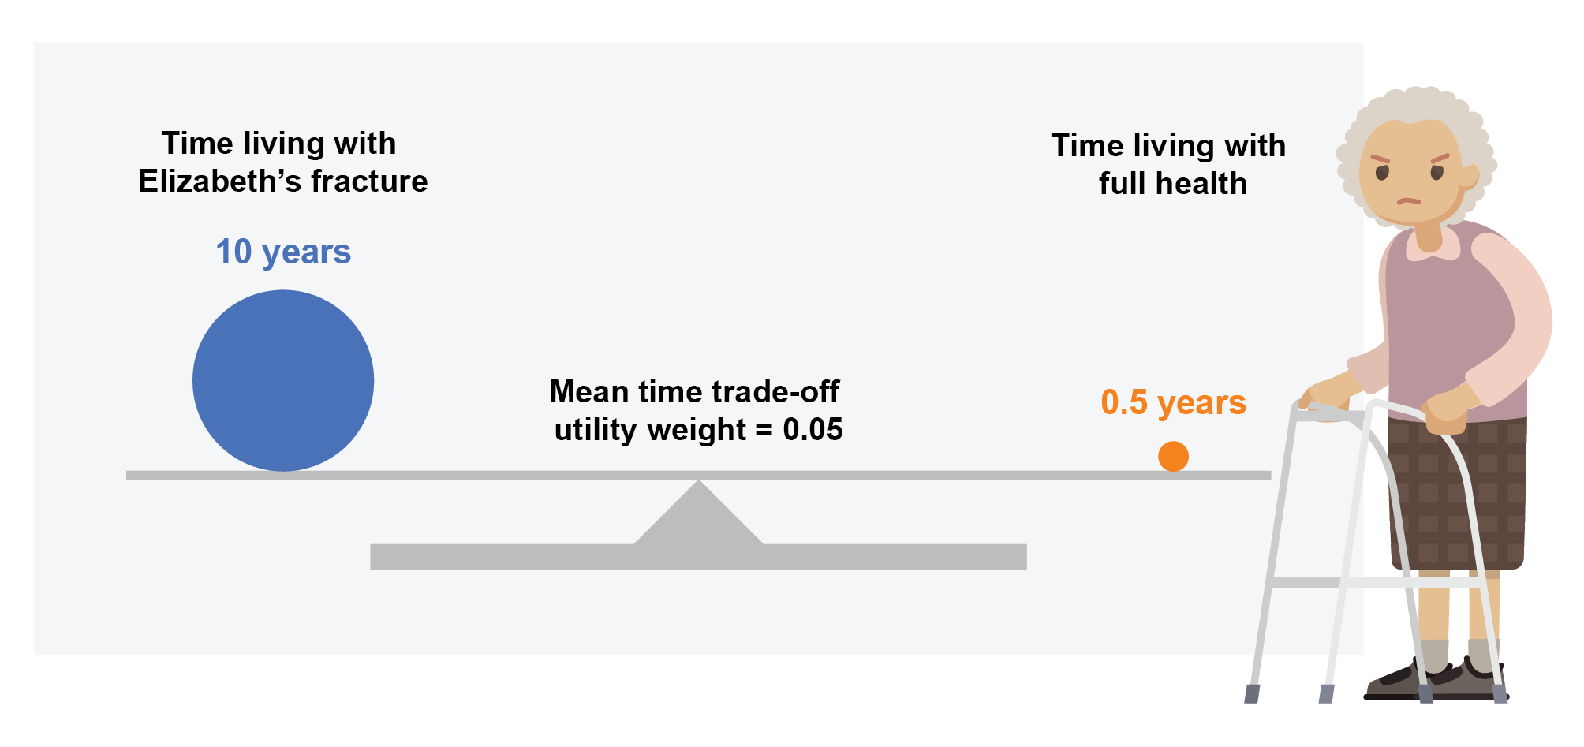
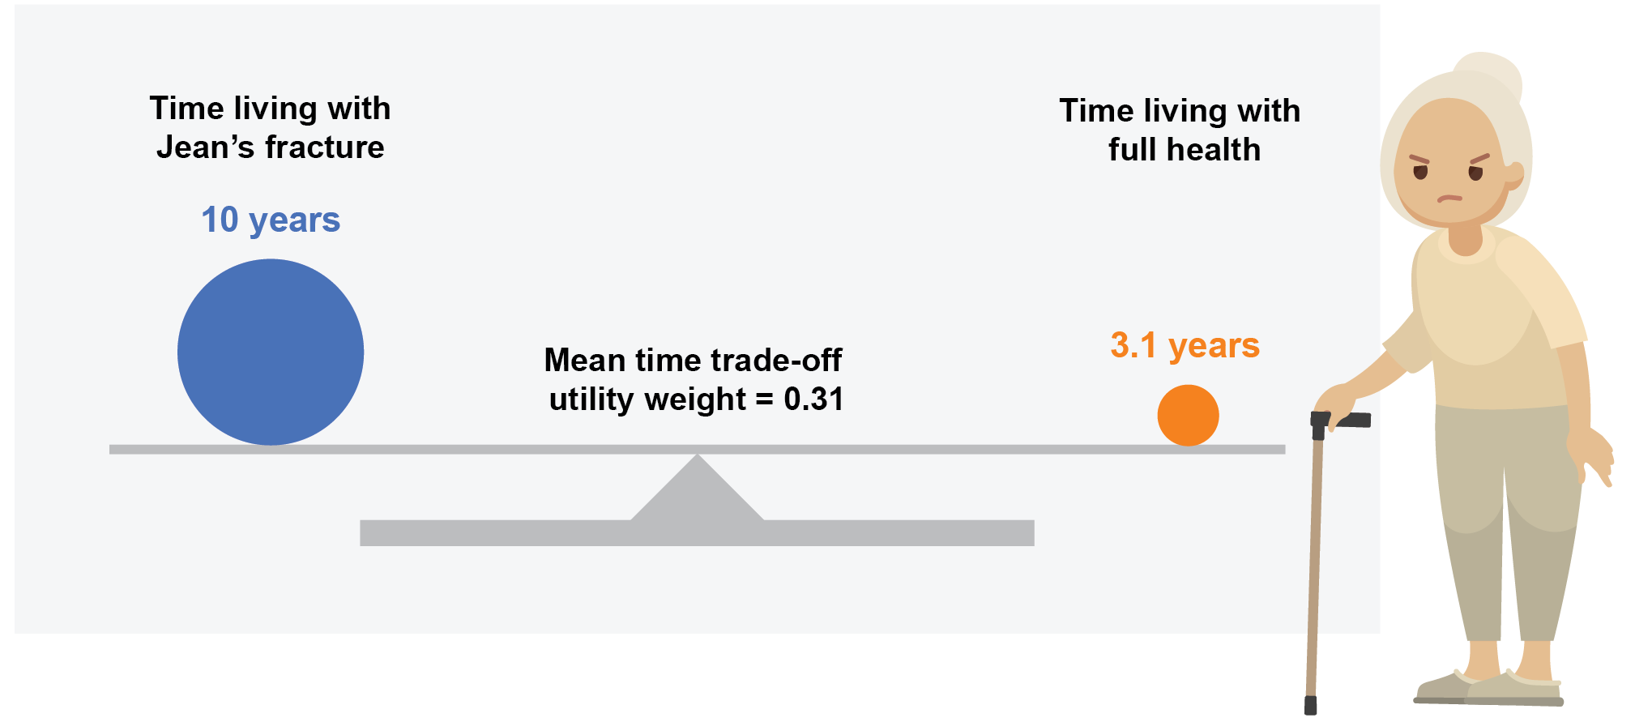
Functional autonomy and independence are highly valued by elderly people at risk of hip fracture
Hip fractures and
ageing
An estimate of the utility (preference for health) associated with hip fracture among elderly women obtained using a time trade-off technique^{1,a}
Utility = 0
would die to avoid a hip fracture like Elizabeth’s
Utility = 1
would not trade off any life expectancy to avoid a hip fracture like Elizabeth’s
Utility = 0
would die to avoid a hip fracture like Jean’s
Utility = 1
would not trade off any life expectancy to avoid a hip fracture like Jean’s
Elderly people would prefer to live for half a year in full health than for 10 years with the consequences of a hip fracture like Elizabeth’s that results in relocation to a nursing home¹
Elderly people would prefer to live for 3.1 years in full health than for 10 years with the consequences of a hip fracture like Jeans’ that results in staying in their own home but with significant limitations¹
80% of respondents stated that they would rather die than experience the loss of independence that results from Elizabeth’s hip fracture that results in relocation to a nursing home¹
Notes:
Salkeld et al. (2000)¹
Type of study. Patient survey (embedded in a randomised controlled trial [RCT]).
Enrolment period. April 1997–July 1998.
194 women enrolled in a RCT, or who were eligible for the RCT but refused consent to participate. The RCT was assessing external hip protectors.
Location. Sydney, Australia.
Participants. for use in community-dwelling, elderly women at risk of hip fracture. The RCT participants were living in the northern suburbs of Sydney, Australia, had contact with an aged care health service, and had experienced ≥ 2 falls, or 1 fall requiring hospital treatment, in the past year.
Age of participants. ≥ 75 years (mean: 83 years [range: 75–98]).
Sex of participants. 100% female.
Follow-up. Not applicable.
Outcomes. Estimated utility (preference for health) associated with hip fracture and fear of falling, reported as mean/median time trade-off utility weights for health states (fear of falling, ‘bad’ hip fracture and ‘good’ hip fracture). A ‘bad’ hip fracture (Elizabeth) results in admission to a nursing home and a ‘good’ hip fracture (Jean) results in maintaining semi-independent living in the community.
Assessment of outcomes. By quality of life face-to-face interview. Respondents were asked to rate their own health by using the 5-dimensions EuroQoL questionnaire (EQ-5D), and then to rate three health states (fear of falling, a ‘good’ hip fracture and a ‘bad’ hip fracture) by using the time trade-off technique. Time trade-off utility weights are provided on an interval scale between utility = 0 (a shorter life in full health) and utility = 1 (a longer life of lower quality). The technique derives an estimate of preference for health states by finding the point at which respondents show no preference between a longer life of lower quality or a shorter life in full health. The differences in mean utility weights between the trial groups (patients using and not using hip protectors), and the refusers, were not significant. A test­–retest study on 36 women found that the results were reliable with correlation coefficients that ranged from 0.61 to 0.88 for the three health states.
Scoring of ‘time trade-off utility weights’ (in more detail). The time trade-off technique asks respondents to choose between two alternatives, both with certain outcomes. In this study, participants were asked to con­sider living in a state of less than full health for a defined period of time (t = 5 or 10 years, depending on their age) and then to die. The alternative was to consider living for a shorter period of time in full health and then to die. The time (x) in full health was varied until the respondent was indifferent between the two alternatives. The choice of scenarios was presented to respondents in 6 month and 1 year increments for the 5- and 10-year interview schedules, respectively. If a respondent would trade-off no more than 6 months or 1 year, respectively, then they were asked to trade-off in smaller increments of 1 or 2 months, respectively. The utility weight for each health state is given by the formula x/t.
Reference
Salkeld G et al. BMJ 2000;320:341–6.

Slide 8
The pathway to loss of function and disablement in elderly people after hip fracture
Hip fractures and
ageing
Pathology
osteoporosis,
fragility fracture
Impairment
dysfunction and structural abnormalities in the musculoskeletal system
Functional limitation
restriction in physical functioning
Disability
difficulties in performing activities of daily living with a detrimental effect on functional autonomy and independence, and quality of life¹
Notes:
Please note that the World Health Organization have produced the international classification of functioning, disability and health, known as the ICF. This provides a standard language and framework for the description of health and health-related states, such as changes in body structure and function, what a person with a health condition can do in a standard environment (level of capacity), and what they actually do in their usual environment (level of performance).¹
These domains are classified from bodily, individual and societal perspectives by means of two lists: a list of body structure and functions, and a list of domains of activity and participation. The term ‘functioning’ refers to all body functions, activities and participation, while the term ‘disability’ is an umbrella term for impairments, activity limitations and participation restrictions. The ICF also lists environmental factors that interact with all of these components.¹
Kerr C et al. (2017) reported a qualitative study that provided insight into the effects of osteoporosis on patient’s physical function and consequent disability. The study combined a literature review with semi-structured patient interviews and expert interpretation. In total, 27 out of the 39 patients interviewed (69%) had experienced at least one osteoporotic fracture.²
The study provided several insights.²
Hip fractures are immediately debilitating, limit mobility and result in hospitalisation.
Impairments and functional limitations due to hip fractures often persist long after the fracture event, and may restrict participation in life roles or the capacity to live independently.
Reductions in physical function often result in a shift in family and societal roles, which can contribute toward low self-esteem.
Individuals may experience fear – particularly a fear of falling or fracture – and adverse psychological outcomes, which can add to limitations in physical function, and to reduced social interaction and participation.
Comorbid conditions, especially arthritis, can make daily activities requiring physical function even harder – some comorbidities can also increase the risk of fracture, especially if they increase the risk of falls.
References
World Health Organization. 2002. Available from: http://www.who.int/classifications/icf/training/icfbeginnersguide.pdf (Accessed January 2018).
Kerr C et al. Osteoporos Int 2017;28:1597–607.

Slide 9
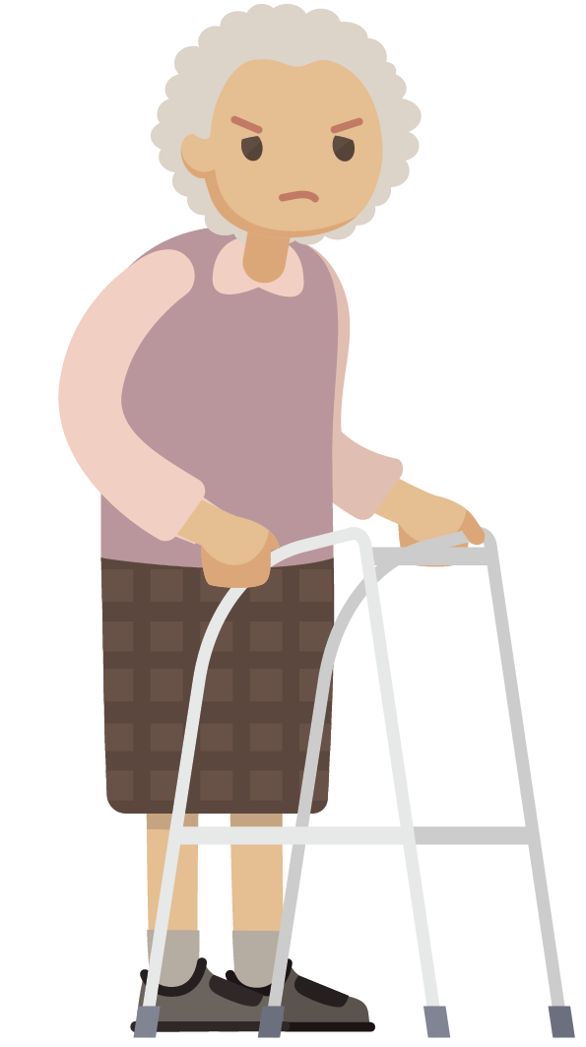
Elderly people may be forced to relocate to a care or nursing home after hip fracture
The proportion of patients newly living in a nursing home up to 1 year after hip fracture^{1,a}
Hip fractures and
residence
Key to symbols used throughout
Residence before fracture:
Living in the community
Living in a care or nursing home
Mixed cohort
In one of the studies, like Elizabeth, 19% of elderly patients were living in a nursing home 1 year after hip fracture compared with only 4% of controls matched for age and residence before fracture²
Givens et al. 2008
Holt
et al. 2008
Beaupre et al. 2005
Autier
et al. 2000
Shah
et al. 2001
Residence before fracture
Notes:
Dyer SM et al. (2016) is a literature review of data from 38 cohort studies reported in 42 publications. Please see the supplementary slides for an assessment of study limitations and bias.¹
Dyer SM et al. (2016)¹
Type of study. Non-systematic literature review of cohort studies, also including population-based cohort studies and studies with comparisons to patients who did not experience a hip fracture.
Recruitment period. 1976–2014.
Locations. Australia, Belgium, Brazil, Canada, China, Italy, Japan, New Zealand, Netherlands, Norway, Singapore, Spain, Sweden, Thailand, UK and USA (no African, and few South American and South-East Asian countries).
Cases. Obtained from 38 hip fracture studies reported in 42 publications (the largest study included 60 111 hip fracture cases² and the smallest included 67 cases³).
Follow-up. Studies were included if the duration of follow-up was ≥ 3 months after the hip fracture.
Review question and protocol. This was developed a priori and the findings were synthesised into a narrative summary.
Study identification. By searches of PubMed, Scopus and hip fracture registries between November and December 2015. Additionally, through existing systematic reviews, reference lists of included studies and contact with experts.
Study inclusion. Cohort studies reporting outcomes of mobility, self-care, participation (domestic and community), health condition and/or quality of life at ≥ 3 months after hip fracture. Studies were required to have ≥ 75% of patients aged > 60 years, or a mean patient age of > 60 years, or patients who experienced hip fracture due to low-energy trauma only.
Study exclusion. Enrolment based on the intervention received. Patients in most studies were treated surgically as it is considered to be the standard of care in developed countries, although studies were excluded if patients were enrolled based on the type of surgery they received.
Study bias. Assessed against four criteria adapted from the Strengthening the Reporting of Observational Studies in Epidemiology (STROBE) statement (rated: yes, no or unclear).⁴
Outcomes.
Main outcomes were extracted and categorised as assessing activity (execution of an action or task) or participation (involvement in a life situation) according to the World Health Organization international classification of functioning, disability and health (ICF) framework.⁵
Outcomes reported related to: mobility, participation (in self-care, domestic and community activities), accommodation, health-related quality of life and health condition.
Outcomes reported were assessed in relation to: time to recovery of function (or recovery at multiple follow-up times), the proportion of patients recovering pre-fracture function, or function in comparison to a non-fracture control group.
Not all outcomes reported in each study were included in the analysis, and outcomes reported at discharge or < 3 months post-fracture were not included.
Pooling of study outcomes was not carried out because of the heterogeneous nature of their type and reporting, therefore outcomes were synthesised into a narrative summary.
References
Dyer SM et al. BMC Geriatr 2016;16:158.
Neuman MD et al. JAMA Intern Med 2014;174:1273–80.
Tosteson AN et al. Osteoporos Int 2001;12:1042–9.
von Elm E et al. PLoS Med 2007;4(10):e296
World Health Organization. 2002. Available from: http://www.who.int/classifications/icf/training/icfbeginnersguide.pdf (Accessed January 2018).
References from Dyer et al. (2016)¹
Autier P et al. Osteoporos Int 2000;11:373–80.
Beaupre LA et al. Arch Phys Med Rehabil 2005;86:2231–9.
Givens JL et al. J Am Geriatr Soc 2008;56:1075–9.
Holt G et al. J Bone Joint Surg Am 2008;90:1899–905.
Shah MR et al. J Orthop Trauma 2001;15:34–9.

Slide 10
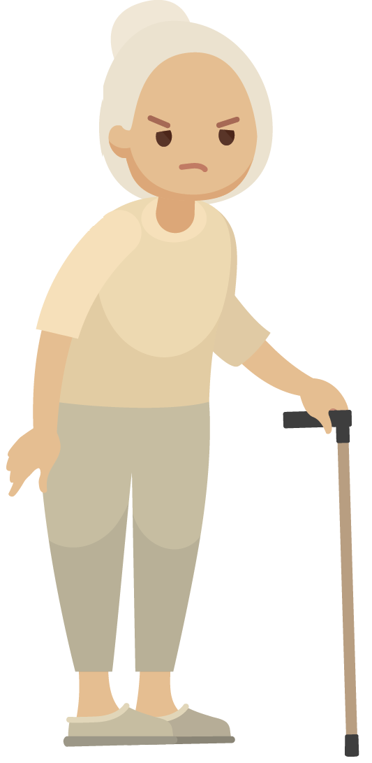
Even elderly people aged 80 years old or younger may be living in a care or nursing home after hip fracture
The proportion of patients living in their own homes, compared with care/nursing homes, after a hip fracture¹
Hip fractures and
residence
Dead
Rehabilitation unit/hospital
Residential/ nursing home
Own/sheltered home
Like Elizabeth, 17% of elderly people ≤ 80 years old were living in a residential or nursing home at 1 year after hip fracture compared with 7% before fracture, and 12% had died¹
Like Jean, 70% of elderly people ≤ 80 years old were living in their own home or a sheltered home 1 year after hip fracture compared with 85% before fracture¹
Notes:
Griffin XL et al. (2015)¹
Type of study.¹ Non-comparator prospective cohort study (baseline was assessed retrospectively via the patient or a proxy).
Enrolment period. January 2012–March 2014.
Location. A single United Kingdom trauma centre (University Hospitals Coventry and Warwickshire NHS Trust).
Cases. 741 hip fracture cases (all apart from five patients were managed surgically).
Age of cases. ≥ 60 years (mean: 83.1 years [SD: 8.7]).
Sex of cases. 67.9% female.
Follow-up. 1 year, where possible (data were available for 403 patients at 1 year, including 118 deaths).
Primary outcome. 5-dimension EuroQol questionnaire (EQ-5D) score.
This study was included in the Dyer et al. (2016) review.²
References
Griffin XL et al. Bone Joint J 2015;97-B:372–82.
Dyer SM et al. BMC Geriatr 2016;16:158.

Slide 11
Hip fractures restrict elderly people’s mobility in the medium term
The proportion of patients requiring walking aids 1 year after hip fracture, compared with before fracture¹
There was a 1.6-point (27%) reduction (SD: 1.5) in mean mobility scoreª from before fracture to 1 year after hip fracture¹
The mean mobility score before fracture was 6.0 (SD: 2.6) and the mean mobility score 1 year after fracture was 4.4 (SD: 2.2)¹
Hip fractures and
mobility
Unaided
With sticks
With a frame
Immobile
Notes:
Mobility score.^{1,2} A point-scoring system for three mobility functions. (1) Can the patient do their own shopping? (2) Is the patient able to get out of the house? (3) Is the patient able to get about the house? Each function is scored out of a maximum of three points.
3 points: able to do independently, without using an aid
2 points: able to do independently, but using an aid
1 point: able to do, but with the assistance of another person
0 points: unable to do (bed, chair or housebound).
The highest possible score is 9 (full independence in performing all three functions), and the lowest possible score is 0 (unable to perform all three functions, even with assistance).
Keene et al. (1993)¹
Type of study. Non-comparator prospective cohort study.
Enrolment period. 1989–1992.
Location. Two United Kingdom trauma centres (Birmingham Accident Hospital and the Peterborough District Hospital [as they were known at the time of the study]).
Cases. 1000 consecutive acute hip fracture cases occurring in 972 patients.
Age of cases. Mean: 78 years (intracapsular fractures) and 80 years (extracapsular fractures).
Sex of cases. Approximately 81% women.
Follow-up. ≤ 1 year.
Outcomes. Various self-reported measures of health status and functioning, and mortality.
This study was included in the Dyer et al. 2016 review.³
References
Keene GS et al. BMJ 1993;307:1248–50.
Parker MJ, Palmer CR. J Bone Joint Surg Br 1993;75:797–8.
Dyer SM et al. BMC Geriatr 2016;16:158.

Slide 12
Even elderly people aged 80 years old or younger may not be able to walk unaided after hip fracture
The proportion of patients regularly requiring mobility aids when outside after hip fracture^{1,a}
Wheelchair/buggy/ bed bound/never outside
Two aids or a frame
One aid
No aids
Hip fractures and
mobility
Like Elizabeth, 18% of elderly people ≤ 80 years old required two aids or a frame to walk 1 year after hip fracture¹
Like Jean, 28% of elderly people ≤ 80 years old required one aid to walk 1 year after hip fracture¹
Notes:
Griffin XL et al. (2015)¹
Type of study.¹ Non-comparator prospective cohort study (baseline was assessed retrospectively via the patient or a proxy).
Enrolment period. January 2012–March 2014.
Location. A single United Kingdom trauma centre (University Hospitals Coventry and Warwickshire NHS Trust).
Cases. 741 hip fracture cases (all apart from five patients were managed surgically).
Age of cases. ≥ 60 years (mean: 83.1 years [SD: 8.7]).
Sex of cases. 67.9% female.
Follow-up. 1 year, where possible (data were available for 403 patients at 1 year, including 118 deaths).
Primary outcome. 5-dimension EuroQol questionnaire (EQ-5D) score.
This study was included in the Dyer et al. (2016) review.²
References
Griffin XL et al. Bone Joint J 2015;97-B:372–82.
Dyer SM et al. BMC Geriatr 2016;16:158.

Slide 13
Many elderly people do not fully recover their pre-fracture mobility after hip fracture
The proportion of patients who recover pre-fracture mobility after hip fracture^{1,a}
Residence before fracture
Mobile without aid (Vochteloo et al. 2013)
Mobile with aid (Vochteloo et al. 2013)
Walking unaided and unaccompanied (Holt et al. 2008)
Walking independence (Osnes et al. 2004)
Retain community mobility (Norton et al. 2000)
Ambulation independence (Shah et al. 2001)
Level of ambulation (Crotty et al. 2000)
Level of ambulation (Crotty et al. 2000)
Hip fractures and
mobility
–
For people like Elizabeth and Jean who were living in the community before their hip fracture, as many as 56% may not recover pre-fracture mobility²
Notes:
Crotty M et al. (2000): level of ambulation was determined as 100% less the percentage of survivors who deteriorated.^{1,2}
Osnes E et al. (2004): walking independence was determined as 100% less the percentage with loss of walking independence/receiving assistance.^{1,3}
Dyer SM et al. (2016) is a literature review of data from 38 cohort studies reported in 42 publications. Please see the supplementary slides for an assessment of study limitations and bias.¹
References
Dyer SM et al. BMC Geriatr 2016;16:158.
Crotty MJ et al. Qual Clin Pract 2000;20:167–70.
Osnes E et al. Osteoporos Int 2004;15:567–74.
References from Dyer et al. (2016)¹
Crotty M J et al. Qual Clin Pract 2000;20:167–70.
Holt G et al. J Bone Joint Surg Am 2008;90:1899–905.
Norton R et al. Disabil Rehabil 2000;22:345–51.
Osnes E et al. Osteoporos Int 2004;15:567–74.
Shah MR et al. J Orthop Trauma 2001;15:34–9.
Vochteloo AJ et al. Geriatr Gerontol Int 2013;13:334–41.

Slide 14
Even elderly people aged younger than 80 years old are less mobile than matched controls after hip fracture
The proportion of patients with hip fracture (N = 134) able to walk independently at 1 year after fracture, compared with matched controls ^{1,a}
23% fewer patients < 80 years old were able to walk independently at 1 year after hip fracture, compared with matched controls^{1,a}
p < 0.001
p < 0.001
Hip fractures and
mobility
Residence before fracture
Notes:
Boonen S et al. (2004)¹
Type of study.¹ Comparator prospective cohort study (baseline was assessed in hospital at the initial assessment).
Enrolment period. Not specified.
Location. Belgium.
Cases. 170 consecutive patients with hip fracture experiencing a first hip fracture (159 patients with hip fracture survived acute hospitalisation, 138 were alive at 1 year after fracture and none were lost to follow-up).
Age of cases. ≥ 50 years (mean: 78 [range: 50–95]).
Sex of cases. 100% females.
Follow-up. 12 months (only patients who completed the Rapid Disability Rating Scale version 2 [RDRS-2] questionnaires at hospital discharge and 12 months later were included in the analysis – 134 women were alive at 12 months).
Outcomes. Functional status was measured by completing a RDRS-2 questionnaire (score ranging from 0 [best] to 54 [worst]) before discharge from hospital and 12 months later. The RDRS-2 score was assessed by four trained interviewers, both at discharge from hospital and 12 months after discharge. For all patients, the same interviewers performed the baseline and follow-up assessments. Health-related quality of life was measured by completing a short form-36 (SF-36) questionnaire at the same time points. Note that only 87 patients with hip fracture (51%) were able to complete the SF-36 questionnaire at both time points.
Control cases. An equal number of women from the same municipality who had not experienced a hip fracture, matched for age and residence (approximately 50% of women eligible to be controls refused to participate).
This study was included in the Dyer et al. (2016) review.²
The RDRS-2 is a tool³ used to measure the functional capacity and mental status of elderly people with chronic medical conditions. The RDRS-2 comprises 18 items grouped into three domains: activities of daily living (eating, walking, mobility, bathing, dressing, toileting, grooming and adaptive tasks), degree of dependence (communication, hearing, sight, diet, stay in bed during the day, incontinence and medication), and cognitive impairment (mental confusion, uncooperativeness and depression). The 18 items are ranked on a four-point scale, with 0 indicating the best function and 3 the worst. Therefore, total scores can range from 0 (no functional impairment) to 54 (severe global functional impairment), with higher scores indicating poorer function.¹
References
Boonen S et al. Osteoporos Int 2004;15:87–94.
Dyer SM et al. BMC Geriatr 2016;16:158.
Linn MW, Linn BS. J Am Geriatr Soc 1982;30:378–82.

Slide 15
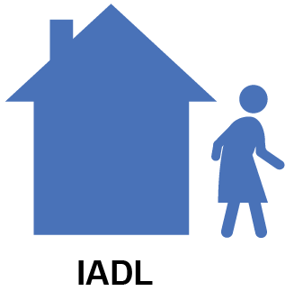
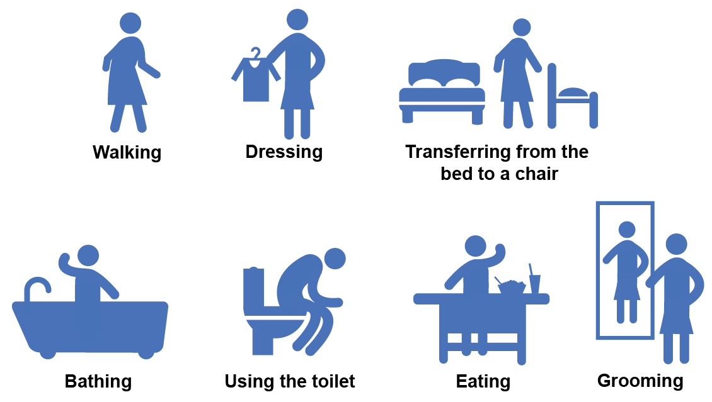
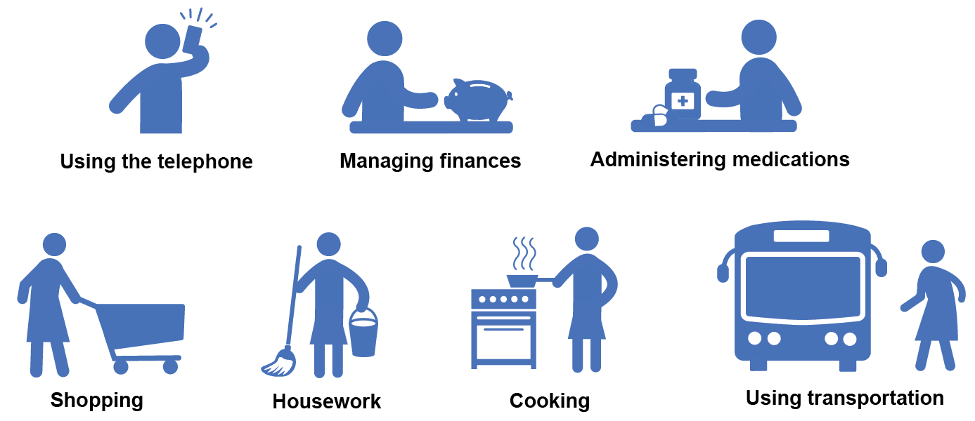
The definition of activities of daily living
Activities of daily living (ADLs) are used to reflect functional autonomy and independence in elderly people,¹ and to evaluate the impact of hip fractures²
There are two types of ADLs, basic and instrumental³
Basic ADLs are capabilities necessary for self-care³
Instrumental ADLs (IADLs) are capabilities necessary for living independently in the community³
Key
ADL
IADL
ADLs
IADLs
Hip fractures and ADLs
Notes:
In this presentation, activities of daily living¹ are used as an outcome that reflects an elderly person’s functional autonomy and independence after hip fracture.²
References
Hardy SE. Considerations of function and functional decline. In: Current diagnosis and treatment: geriatrics, second edition. Williams BA et al. (ed.). Mc Graw Hill Lange. 2014. Available from: http://accessmedicine.mhmedical.com/content.aspx?bookid=953&sectionid=53375624 (Accessed January 2018).
Lowry KA et al. Aging Dis 2012;3:5–15.

Slide 16
Hip fractures restrict elderly people’s ADLs in the medium to long term
The change in the proportion of patients who are independent in ADLs after hip fracture^{1,a}
Time post-fracture (months)
< 6 6–12 > 12
Residence before fracture
-5%
MBI (mean) (Doshi et al. 2014)
ADL independent (%) (Samuelsson et al. 2009)
ADL independent (%) (Norton et al. 2000)
Hip fractures and ADLs
-20%
-22%
-29%
Notes:
Doshi HK et al. (2014): mean Modified Barthel Index (MBI), 91.2 pre-fracture and 87 at 6–12 months post-fracture.^{1,2}
Norton R et al. (2000): proportion of patients independent in activities of daily living (ADLs), 62% pre-fracture and 44% at > 12 months post-fracture.^{1,3}
Samuelsson B et al. (2009): proportion independent in ADLs, 74% pre-fracture and 58% at < 6 months and 59% at > 12 months post-fracture.^{1,4}
Dyer SM et al. (2016) is a literature review of data from 38 cohort studies reported in 42 publications. Please see the supplementary slides for an assessment of study limitations and bias.¹
The MBI⁵ is widely used in geriatric assessment settings. It measures independence in 10 activities: feeding, bathing, grooming, dressing, bowel continence, bladder continence, toilet use, transfers (bed to chair and back) and mobility (on level surfaces). Total scores range from 0–100 and higher scores indicate greater functional independence.⁶
References
Dyer SM et al. BMC Geriatr 2016;16:158.
Doshi HK et al. Arch Orthop Trauma Surg 2014;134:489–93.
Norton R et al. Disabil Rehabil 2000;22:345–51.
Samuelsson B et al. Age Ageing 2009;38:686–92.
Mahoney FI, Barthel D. Maryland State Med J 1965;14:56–61.
Royal Australian College of General Practitioners. 2006. Available from: https://www.racgp.org.au/download/documents/Guidelines/silverbook.pdf (Accessed January 2018).
References from Dyer et al. (2016)⁴
Doshi HK et al. Arch Orthop Trauma Surg 2014;134:489–93.
Norton R et al. Disabil Rehabil 2000;22:345–51.
Samuelsson B et al. Age Ageing 2009;38:686–92.

Slide 17
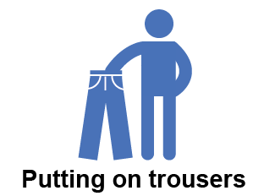
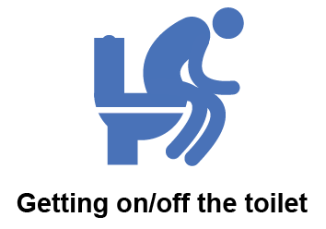
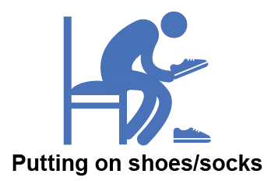
Many elderly people do not recover their pre-fracture capabilities in self-care after hip fracture
The proportion of patients recovering independence in specific self-care ADLs after hip fracture¹
Residence before fracture
Pre-fracture
6–12 months post-fracture
> 12 months post-facture
Hip fractures and ADLs
For people like Elizabeth and Jean who were living independently in the community before their hip fracture, as many as 60% may require assistance with self-care ADLs 1 year after fracture^{1,2,a}
Notes:
The absence of a matched control cohort makes it difficult to establish to what extent self-care activities of daily living were affected by ageing alone. The least healthy patients dropped out of the study the earliest.¹
Magaziner et al. (2000)¹
Type of study. Non-comparator prospective cohort study (baseline was assessed retrospectively via the patient or a proxy, and chart review).
Enrolment period. 1 January 1990–15 June 1991.
Location. Eight hospitals in Baltimore, MD, USA (Baltimore Hip Studies).
Cases. 674 patients with hip fracture (community-dwelling at the time of fracture).
Age of cases. ≥ 65 years (mean: 81.1 years [standard deviation (SD): 7.4]).
Sex of cases. 77.4% women.
Follow-up. ≤ 2 years (2, 6, 12, 18 and 24 months; 389 patients interviewed at 24 months).
Outcomes. Various self-reported measures of health status and functioning, Mini-Mental State Examination (MMSE; cognitive functioning) and objective/semi-objective assessments of neuromuscular functioning. To identify the point at which the maximal level of recovery had occurred for each aspect of function, longitudinal data were analysed using the system of generalised estimating equations.
This study was included in the Dyer et al. (2016) review.²
References
Magaziner J et al. J Gerontol A Biol Sci Med Sci 2000;55:M498–M507.
Dyer SM et al. BMC Geriatr 2016;16:158.

Slide 18
Even elderly people living in the community are less capable of ADLs after hip fracture
Hip fractures and ADLs
of those living in the community before their fracture do not recover their pre-fracture capabilities in ADLs¹
of those living in long-term care before their fracture do not recover their pre-fracture capabilities in ADLs¹
Notes:
The study reported in Beaupre et al. (2007)¹ was included in the Dyer et al. (2016) review.² Dyer SM et al. (2016) is a literature review of data from 38 cohort studies reported in 42 publications. Please see the supplementary slides for an assessment of study limitations and bias.²
Beaupre LA et al. (2007)¹
Type of study. Non-comparator prospective cohort study (baseline assessed retrospectively via the patient or a proxy).
Enrolment period. July 1999–December 2000.
Location. Two hospitals in one tertiary health region in Alberta, Canada.
Cases. 451 consecutive patients with hip fracture (115 long-term care [LTC] residents and 336 community-dwelling residents). Eligible patients with hip fracture were identified through admissions records.
Age of cases. ≥ 65 years (mean: 85.0 [standard deviation (SD): 7.3] in the LTC population and 80.7 [SD: 7.7] in the community-dwelling population).
Sex of cases. 81% female in the LTC population and 77% females in the community population.
Follow-up. 6 months (loss to follow-up was 11% in the LTC population and 15% in the community population at 6 months; 11 patients in total had died by 6 months).
Outcomes. Various self-reported measures of functioning. Participants completed the Modified Barthel Index (MBI) in hospital and again via telephone interviews 6 months postoperatively. Data were also collected on surgery and rehabilitation timing, length of hospital stay and discharge destination. Relative change from pre-fracture function, adjusting for known prognostic factors, and the proportion of participants returning to pre-fracture function, were compared between the LTC and community-dwelling residents.
This study was included in the Dyer et al. (2016) review.²
The MBI³ is widely used in geriatric assessment settings. It measures dependence in 10 activities: feeding, personal hygiene, bathing, dressing, toilet transfers, bowel control, bladder control, chair and/or bed transfers, walking and stair-climbing. The MBI uses a three-point Likert scale, ‘unable to perform task’ (0 points), ‘needs assistance’ (5 or 10 points), ‘fully independent’ (10 or 15 points). Total scores range from 0–100 and higher scores indicate greater functional independence.¹
References
Beaupre LA et al. J Gerontol Series A Biol Sci Med Sci 2007;62:1127–33.
Dyer SM et al. BMC Geriatr 2016;16:158.
Mahoney FI, Barthel D. Maryland State Med J 1965;14:56–61.

Slide 19
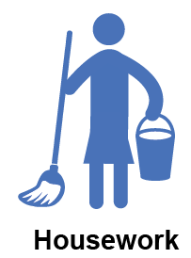
Many elderly people do not fully recover their pre-fracture capabilities in IADLs after hip fracture
The proportion of patients recovering independence in specific IADLs after hip fracture^{1,a}
Residence before fracture
Pre-fracture
6–12 months post-fracture
> 12 months post-fracture
Hip fractures and ADLs
For people like Elizabeth and Jean who were living independently in the community before their hip fracture, as many as 53% may require assistance with specific IADLs, such as getting out and about, more than 1 year after fracture^{1,b}
Notes:
The absence of a matched control cohort makes it difficult to establish to what extent instrumental activities of daily living were affected by ageing alone. The least healthy patients dropped out of the study the earliest.¹
Magaziner et al. (2000)¹
Type of study. Non-comparator prospective cohort study (baseline was assessed retrospectively via the patient or a proxy, and chart review).
Enrolment period. 1 January 1990–15 June 1991.
Location. Eight hospitals in Baltimore, MD, USA (Baltimore Hip Studies).
Cases. 674 patients with hip fracture (community-dwelling at the time of fracture).
Age of cases. ≥ 65 years (mean: 81.1 years [standard deviation (SD): 7.4]).
Sex of cases. 77.4% women.
Follow-up. ≤ 2 years (2, 6, 12, 18 and 24 months; 389 patients interviewed at 24 months).
Outcomes. Various self-reported measures of health status and functioning, Mini-Mental State Examination (MMSE; cognitive functioning) and objective/semi-objective assessments of neuromuscular functioning. To identify the point at which the maximal level of recovery had occurred for each aspect of function, longitudinal data were analysed using the system of generalised estimating equations.
This study was included in the Dyer et al. (2016) review.²
References
Magaziner J et al. J Gerontol A Biol Sci Med Sci 2000;55:M498–M507.
Dyer SM et al. BMC Geriatr 2016;16:158.

Slide 20
Even if elderly people do recover ADLs and IADLs after hip fracture it may take a long time
The time to recovery of ADLs and IADLs after hip fracture^{1,a}
The recovery of elderly people after hip fracture is often variable, incomplete and can take a considerable amount of time^{1–3}
The time to maximum recovery can represent as significant proportion of the remaining life expectancy of elderly people^{4,5}
Hip fractures and ADLs
Resident in the community before fracture
Notes:
Lower limb activities of daily living (ADLs) comprise: walking 3 metres, walking one block, climbing five stairs, getting into a car, getting in or out of bed, rising from an armless chair, putting on trousers, putting socks and shoes on both feet, getting in or out of a bath or shower, taking a bath, shower or sponge bath, and getting on or off a toilet.¹
Upper limb ADLs comprise: putting on a shirt or blouse, buttoning a shirt or blouse, feeding self after food is prepared, and grooming (brushing hair and cleaning teeth).¹
Instrumental ADLs comprise: house cleaning, getting to places out of walking distance, shopping, cooking, handling money, taking medications and using the telephone.¹
Magaziner et al. (2000)¹
Type of study. Non-comparator prospective cohort study (baseline was assessed retrospectively via the patient or a proxy, and chart review).
Enrolment period. 1 January 1990–15 June 1991.
Location. Eight hospitals in Baltimore, MD, USA (Baltimore Hip Studies).
Cases. 674 patients with hip fracture (community-dwelling at the time of fracture).
Age of cases. ≥ 65 years (mean: 81.1 years [standard deviation (SD): 7.4]).
Sex of cases. 77.4% women.
Follow-up. ≤ 2 years (2, 6, 12, 18 and 24 months; 389 patients interviewed at 24 months).
Outcomes. Various self-reported measures of health status and functioning, Mini-Mental State Examination (MMSE; cognitive functioning) and objective/semi-objective assessments of neuromuscular functioning. To identify the point at which the maximal level of recovery had occurred for each aspect of function, longitudinal data were analysed using the system of generalised estimating equations.
This study was included in the Dyer et al. (2016) review.²
References
Magaziner J et al. J Gerontol A Biol Sci Med Sci 2000;55:M498–M507.
Dyer SM et al. BMC Geriatr 2016;16:158.

Slide 21
Elderly people are less capable of self-care than matched controls after hip fracture
The self-care and ADL capabilities of patients with hip fracture, compared with matched controls, more than 1 year after hip fracture^{1,a}
8–46% fewer elderly patients with hip fracture were capable of various self-care ADLs at more than 1 year after hip fracture, compared with matched controls¹
**^{c}
Residence before fracture
**
*
*^{b}
No assistance required, grooming (Magaziner et al.2003)
No difficulty putting on socks (Tosteson et al. 2001)
Daily activities not limited (Tosteson et al. 2001)
Retain functional independence (Norton et al. 2000)
–
Hip fractures and ADLs
Cohort
Notes:
Magaziner J et al. (2003): control patients were matched for age, sex and walking ability. The control cohort used is the Iowa Established Populations for Epidemiologic Studies of the Elderly cohort (two other control cohorts were also reported with consistent findings).^{1,2}
Norton R et al. 2000: control patients were matched for age, sex and independence.^{1,3}
Tosteson AN et al. 2001: control patients were matched for age and sex.⁴
Dyer SM et al. (2016) is a literature review of data from 38 cohort studies reported in 42 publications. Please see the supplementary slides for an assessment of study limitations and bias.¹
References
Dyer SM et al. BMC Geriatr 2016;16:158.
Magaziner J et al. Am J Epidemiol 2003;157:1023–31.
Norton R et al. Disabil Rehabil 2000;22:345–51.
Tosteson AN et al. Osteoporos Int 2001;12:1042–9.
References from Dyer et al. (2016)¹
Magaziner J et al. Am J Epidemiol 2003;157:1023–31.
Norton R et al. Disabil Rehabil 2000;22:345–51.
Tosteson AN et al. Osteoporos Int 2001;12:1042–9.

Slide 22
The impact of hip fractures on elderly people is similar to that of other serious chronic diseases
Reductions in HRQoL associated with serious chronic diseases^{1–3,a}
The HRQoL of patients with hip fracture is 25% less than that of women of the same age who have not experienced a hip fracture¹
Hip fractures reduce HRQoL to a similar extent as other serious chronic diseases^{1,2}
Diabetes-related amputations
Diabetes-related visual loss
Hip fracture
Parkinson disease
Multiple sclerosis
-0.20
-0.21
-0.23
-0.28
-0.29
Hip fractures and other serious chronic diseases
Notes:
The 5-dimension EuroQoL (EQ‐5D) is a preference-based questionnaire that is used to assess health-related quality of life (HRQoL).¹ The descriptive system comprises five dimensions: mobility, self‐care, usual activities, pain/discomfort and anxiety/depression. Each dimension comprises three levels: no problems, some problems and extreme problems. The respondents indicate which statement describes their state most appropriately in each of the five dimensions. The five dimensions of the EQ‐5D are scored with values between 1 and 3, with 1 representing the best health status and 3 the worst. A total of 243 (3⁵) possible health states can be defined this way. In this analysis,² utility values were taken from a United Kingdom study, in which the time trade‐off valuation technique was used.3 The overall EQ‐5D index (the utility value) has a theoretical range from -0.594 (worst possible health) to 1.0 (perfect health).²
References
EuroQoL-5 Dimensions-3L score user guide. Available from: https://euroqol.org/wp-content/uploads/2016/09/EQ-5D-3L_UserGuide_2015.pdf (Accessed January 2018).
Vokó Z et al. J Eval Clin Pract 2017;23:1375–80.
Dolan P. Med Care 1997;35:1095–108.

Slide 23
Hip fractures compromise elderly people’s functional autonomy and independence
42–86% of elderly people are alive 1 year after a hip fracture¹
Most recovery in the ability to perform basic ADLs and IADLs may occur in the first 6 months after fracture, although the range is 4–11 months for individual ADLs²
Overall, recovery after hip fracture is associated with ongoing limitations in mobility, self-care, ADLs, IADLs and life participation²
Outcomes for hip fracture survivors^{2,a} | Worst case | Best case
May be forced to relocate to a care or nursing home | 20% | 10%
May require assistance with self-care tasks despite previously being independent | 60% | 20%
May not recover pre-fracture mobility | 60% | 40%
May not recover independence in basic ADLs | 60% | 30%
May not recover independence in IADLs | 60% | 40%
Conclusions and next steps
Notes:
Of hip fracture survivors, up to:¹
10–20% may be forced to relocate to a nursing home in Western nations
20–60% who were previously independent may require assistance with self-care tasks 1–2 years post-fracture
40–60% may regain their pre-fracture mobility, 40–70% their independence in basic ADLs, and 40%–60% their independence in IADLs.
Reference
Dyer SM et al. BMC Geriatr 2016;16:158.

Slide 24
Hip fracture prevention can be suboptimal
Despite the importance of maintaining functional autonomy and independence in elderly people at risk of fragility fractures, there is evidence that osteoporosis is often managed suboptimally^{1–10}
Many patients are not properly managed, even if they are at high risk of, or have previously experienced, a fragility fracture¹⁰
Conclusions and next steps
Notes:
Yang X et al. (2016)¹ reported that of 109 829 women aged ≥ 65 years old with a diagnosis of osteoporosis between 2007 and 2011, 71.4% did not receive osteoporosis treatment during 2012, including 75.9% of the subgroup of patients with a prior fracture.¹
Siris ES et al. (2014)² reported that of 65 344 women aged ≥ 55 years old with a diagnosis of osteoporosis between 2001 and 2010, 64.3% received not receive osteoporosis treatment within 1 year of being diagnosed with osteoporosis.²
Solomon DH et al. (2014)³ reported that the Kaplan–Meier-estimated probability of osteoporosis medication use within 12 months following discharge from hospital after a hip fracture was 28.5%.³
References
Yang X et al. Curr Med Res Opin 2016;32:1849–56.
Siris ES et al. Curr Med Res Opin 2014;30:123–30.
Solomon DH et al. J Bone Miner Res 2014;29:1929–37.

Slide 25
Take-home messages
A large proportion of elderly people who experience hip fractures survive
Hip fracture survivors experience a loss of functional autonomy and independence compared with before fracture, and compared with matched controls who have not experienced a hip fracture
Despite the limitations imposed by hip fractures, some elderly people do recover pre-fracture capabilities
Effective interventions are available to help prevent hip fractures
The burden of hip fractures is likely to continue to be an important issue for patients, healthcare professionals, societies and policy makers, especially as the global population continues to age and the prevalence of hip fractures continues to rise
Conclusions and next steps

Slide 26
Supplementary slides (1/2)
Study limitations, study bias
and future research directions

Slide 27
Assessment of study limitations
Heterogeneity across observational studies with regards to:
patient and treatment characteristics, which likely reflects different cohort inclusion criteria¹
methods for measuring and reporting outcomes¹
Paucity of data across observational studies on:
some outcomes, in particular those related to participation in social and community life¹
hip fractures in men – although hip fractures are more common in women than in men, a substantial number of men worldwide are affected by hip fractures^{1,2}
patients living in a care or nursing home pre-fracture – these patients may have a poorer pre-fracture function and recovery potential than patients living independently^{1,3}
the burden of hip fractures on caregivers⁴
Observational studies and literature reviews were not always reported according to STROBE and PRISMA guidelines, respectively⁵ – in particular, some studies did not report loss to follow-up for each outcome¹
Most studies did not report risk factors or predictors for recovery, or ongoing loss of mobility, functional autonomy or independence¹
Most studies did not attempt to evaluate the relative effectiveness of different interventions in hip fracture management¹

Slide 28
Assessment of study bias (1)
Cohort studyª | Representative?^{b} | Inception?^{c} | Defined sample?^{d} | Adequate follow-up?^{e}
Autier et al. 2000 | Y | Y | Y | Y
Beaupre et al. 2007 | Y | Y | Y | Y
Beaupre et al. 2005 | Y | Y | Y | Y
Bentler et al. 2009 | N | Y | Y | N
Boonen et al. 2004 | Y | Y | Y | Y^{f}
Crotty et al. 2000 | Y | Y | Y | Y
Doshi et al. 2014 | U | Y | Y | U
Givens et al. 2008 | Y | Y | Y | Y
Griffin et al. 2015 | Y | Y | Y | Y
Holt et al. 2008 | N | Y | Y | N
Keene et al. 1993 | Y | Y | N | Y
Notes:
Study bias was assessed according to Dyer et al. (2016)¹ against four questions adapted from the ‘Strengthening the Reporting of Observational Studies in Epidemiology’ (STROBE) statement2 (rated yes, no or unclear).¹
References
Dyer SM et al. BMC Geriatr 2016;16:158.
von Elm E et al. PLoS Med 2007;4:e296.
Slide references
Autier P et al. Osteoporos Int 2000;11:373–80.
Beaupre LA et al. J Gerontol Series A Biol Sci Med Sci 2007;62:1127–33.
Beaupre LA et al. Arch Phys Med Rehabil 2005;86:2231–9.
Bentler SE et al. Am J Epidemiol 2009;170:1290–9.
Boonen S et al. Osteoporos Int 2004;15:87–94.
Crotty M J et al. Qual Clin Pract 2000;20:167–70.
Doshi HK et al. Arch Orthop Trauma Surg 2014;134:489–93.
Givens JL et al. J Am Geriatr Soc 2008;56:1075–9.
Griffin XL et al. Bone Joint J 2015;97-B:372–82.
Holt G et al. J Bone Joint Surg Am 2008;90:1899–905.
Keene GS et al. BMJ 1993;307:1248–50.

Slide 29
Assessment of study bias (2)
Cohort studyª | Representative?^{b} | Inception?^{c} | Defined sample?^{d} | Adequate follow-up?^{e}
Magaziner et al. 2003 | Y | Y | Y | Y
Magaziner et al. 2000 | Y | Y | Y | Y
Miller et al. 2009 | Y | Y | Y | N
Norton et al. 2000 | Y | Y | Y | Y
Osnes et al. 2004 | Y | N | Y | Y
Samuelsson et al. 2009 | Y | Y | Y | Y
Shah et al. 2001 | Y | Y | Y | Y
Tang et al. 2017 | U | N | Y | Y
Tosteson et al. 2001 | Y | N | Y | U
Tsuboi et al. 2007 | Y | Y | Y | U
Vergara et al. 2014 | U | Y | Y | Y
Vochteloo et al. 2013 | Y | Y | Y | Y
Notes:
Study bias was assessed according to Dyer et al. (2016)¹ against four questions adapted from the ‘Strengthening the Reporting of Observational Studies in Epidemiology’ (STROBE) statement2 (rated yes, no or unclear).¹
References
Dyer SM et al. BMC Geriatr 2016;16:158.
von Elm E et al. PLoS Med 2007;4:e296.
Slide references
Magaziner J et al. Am J Epidemiol 2003;157:1023–31.
Magaziner J et al. J Gerontol 2000;M498–M507.
Miller RR et al. Age Ageing 2009;38:570–5.
Norton R et al. Disabil Rehabil 2000;22:345–51.
Osnes E et al. Osteoporos Int 2004;15:567–74.
Samuelsson B et al. Age Ageing 2009;38:686–92.
Shah MR et al. J Orthop Trauma 2001;15:34–9.
Tang VL J et al. J Gen Intern Med 2017;32:153–58.
Tosteson AN et al. Osteoporos Int 2001;12:1042–9.
Tsuboi M et al. Bone Joint Surg 2007;89:461–6.
Vergara I et al. BMC Geriatr 2014;14:124.
Vochteloo AJ et al. Geriatr Gerontol Int 2013;13:334–41.

Slide 30
Future research directions
Future studies should aim to:
measure the impact of hip fractures on IADLs, and domestic, social and community life participation, because these outcomes are relatively under-reported in the literature¹
measure the proportion of patients who regain their pre-fracture level of function or participation, and report raw data to allow comparison and pooling of outcomes across different study populations and settings¹
be reported according to the STROBE guidelines^{1,2}
There continues to be a need for further research into interventions that may improve long-term functional recovery, especially as the burden of hip fractures is likely to increase with population ageing¹

Slide 31
Supplementary slides (2/2)
Additional data, and tabulated data already presented graphically from Dyer et al. (2016)¹
1. Dyer SM et al. BMC Geriatr 2016;16:158

Slide 32
Elderly people may be forced to relocate to care or nursing homes after hip fracture
Outcomes related to residence reported in individual studies from a large literature review¹
Study reference | Outcomeª | Pre-fracture | Time post-fracture
 |  |  | < 6 months | 6–12 months | > 12 months
Bertram et al. 2011² | Remaining in own home | – | – | – | 77%^{b}
Samuelsson et al. 2009³ | Remaining in own home Women Men | 77% 82% | 79% 86% | – | 63% 75%
Tsuboi et al. 2007⁴ | Remaining in own home | 84% | 60% | 81% | –
Hip fractures and
residence
In one study, cognitive function was the most important factor associated with the return of elderly patients to their own homes after hip fracture³
Notes:
Dyer SM et al. (2016) is a literature review of data from 38 cohort studies reported in 42 publications.¹
For each prospective cohort study included in the Bertram et al. (2011) review,² the difference between the proportion of patients with disability pre-fracture and post-fracture was calculated, and the difference was attributed directly to the hip fracture. A weighted average (weight equal to sample size) was calculated for each of the commonly reported outcomes to determine the proportion of patients with long-term disability as a result of a hip fracture. As not all studies reported on every outcome, not all were included in the estimation of each weighted average.²
References
Dyer SM et al. BMC Geriatr 2016;16:158.
Bertram M et al. Inj Prev 2011;17:365–70.

Slide 33
Many elderly people do not fully recover their pre-fracture mobility after hip fracture
Outcomes related to mobility ADLs reported in individual studies from a large literature review¹
Study reference | Mobility-related outcomeª | Pre-fracture residence | Proportion of survivors who recovered their pre-fracture capabilities post-fracture
 |  |  | 3–4 months | 6 months | 12 months | 24 months
Vochteloo et al. 2013 | Mobility without aid Mobility with aid | Mixed | 27% 58% | – | 40% 58% | –
Bentler et al. 2009 | Mobility activities without difficulty^{b} | Not reported | – | – | – | 47%
Holt et al. 2008 | Walk unaided and unaccompanied Aged 75–89 years Aged ≥ 95 years | Mixed | 22% 2% | – | – | –
Osnes et al. 2004 | Walking independence^{c} | Mixed | – | – | 44% | –
Shah et al. 2001 | Ambulatory independence | Community | – | – | 44% | –
Crotty et al. 2000 | Level of ambulation^{d} | Community Long-term care | 69% 58% | – | – | –
Norton et al. 2000 | Retain community mobility | Mixed | – | – | – | 54%
Koval et al. 1998 | Ambulatory ability | Community | 22% | 38% | 47% | –
Hip fractures and
mobility
Notes:
Dyer SM et al. (2016) is a literature review of data from 38 cohort studies reported in 42 publications.¹
Reference
Dyer SM et al. BMC Geriatr 2016;16:158.
References from Dyer et al. (2016)¹
Bentler SE et al. Am J Epidemiol 2009;170:1290–9.
Crotty M J et al. Qual Clin Pract 2000;20:167–70.
Holt G et al. J Bone Joint Surg Am 2008;90:1899–905.
Koval KJ et al. Eff Gen Versus Reg Anesth Clin Orthop Relat Res 1998;348:37.
Norton R et al. Disabil Rehabil 2000;22:345–51.
Osnes E et al. Osteoporos Int 2004;15:567–74.
Shah MR et al. J Orthop Trauma 2001;15:34–9.
Vochteloo AJ et al. Geriatr Gerontol Int 2013;13:334–41.

Slide 34
Elderly people are less mobile than matched controls after hip fracture (1)
The proportion of patients (N = 594) dependent on assistance after hip fracture, compared with matched controls ^{1,a}
There were 26 additional cases of disability per 100 persons in the hip fracture cohort, compared with the control cohorts, during follow-up¹
Hip fracture cohort (Baltimore)
East Boston (control cohort)
Iowa (control cohort)
New Haven (control cohort)
Hip fractures and
mobility
p < 0.001
p < 0.001
Notes:
Magaziner J et al. (2003)¹
Type of study. Comparator prospective cohort study (baseline assessed retrospectively via the patient or a proxy, and chart review).
Enrolment period. 1990–1991.
Location. Eight hospitals in Baltimore, MD, USA (Baltimore Hip Studies).
Cases. 594 consecutive patients with hip fractures (community-dwelling at the time of fracture; pathological fractures excluded).
Age of cases. ≥ 65 years (mean: 80.5 years [standard deviation: 7.3]).
Sex of cases. 75.4% female.
Follow-up. ≤ 2 years.
Outcomes. Self-reported measures of ability to perform various activities of daily living.
Comparator cohort. Community-dwelling patients from the Established Populations for Epidemiologic Studies of the Elderly (EPESE) cohort matched on age, sex and walking ability.
This study was included in the Dyer et al. (2016) review.²
References
Magaziner J et al. Am J Epidemiol 2003;157:1023–31.
Dyer SM et al. BMC Geriatr 2016;16:158.

Slide 35
Elderly people are less mobile than matched controls after hip fracture (2)
Outcomes related to mobility ADLs reported in individual studies from a large literature review¹
Study reference | Outcomeª | Time post-fracture | Controls matched for | Hip fracture patients | Control patients | p value
Boonen et al. 2004 | Able to walk independently Aged < 80 years Aged > 80 years | 1 year | Age, residence | 70% 44% | 93% 85% | < 0.001 < 0.001
Norton et al. 2000 | Retain community mobility | 2 years | Age, sex | 54% | 87% | < 0.001^{b}
Wolinsky et al. 1997 | Mean increase in the number of lower body limitations Mean increase in the number of upper body limitations | 2.3 years^{c} | Nil^{d} | 1.75% 0.50% | 0.75% 0.27% | ≤ 0.0001 < 0.001
Hip fractures and
mobility
Notes:
Dyer SM et al. (2016) is a literature review of data from 38 cohort studies reported in 42 publications.¹
Reference
Dyer SM et al. BMC Geriatr 2016;16:158.
References from Dyer et al. (2016)¹
Boonen S et al. Osteoporos Int 2004;15:87–94.
Norton R et al. Disabil Rehabil 2000;22:345–51.
Wolinsky FD et al. Am J Public Health 1997;87:398–403.

Slide 36
Hip fractures restrict elderly people’s self-care and ADLs in the medium to long term
Outcomes related to ADLs and self-care reported in individual studies from a large literature review¹
Study reference | Composite measures of basic ADLsª | Time post-fracture
 |  | Pre-fracture | 3–5 months | 6–9 months | 9–18 months | 19 months– 2 years | 3–5 years | 6–10 years
Doshi et al. 2014 | MBI,² mean | 91.2 | – | 80.8 | 87.0 | – | – | –
Miller et al. 2009 | Requiring assistance with ADLs,^{b} mean number of tasks (SD) No falls 1 fall > 1 fall | 4.4 (3.4) 4.8 (3.4) 5.6 (3.2) | – | 7.0 (3.3) 8.0 (2.7) 8.7 (3.0) | 6.9 (3.4) 6.7 (2.9) 9.2 (2.9) | – | – | –
Samuelsson et al. 2009 | ADL independent | 74% | – | 58% | – | 59% | – | –
Norton et al. 2000 | Functionally independent | 62% | – | – | – | 44% | – | –
Koval et al. 1998 | Functional recovery^{c} | – | 77% | 86% | 86%
Borgquist et al. 1990 | Dressing/personal hygiene independent | 89% | 83% | – | 88% | – | 83% | 92%
Magaziner et al. 1990 | Fully independent in basic ADLs | 70% | 14%^{d} | – | 40% | – | – | –
Hip fractures and ADLs
Notes:
Dyer SM et al. (2016) is a literature review of data from 38 cohort studies reported in 42 publications.¹
The MBI² is widely used in geriatric assessment settings. It measures independence in 10 activities: feeding, bathing, grooming, dressing, bowel continence, bladder continence, toilet use, transfers (bed to chair and back) and mobility (on level surfaces). Total scores range from 0–100 and higher scores indicate greater functional independence.³
References
Dyer SM et al. BMC Geriatr 2016;16:158.
Mahoney FI, Barthel D. Maryland State Med J 1965;14:56–61.
Royal Australian College of General Practitioners. 2006. Available from: https://www.racgp.org.au/download/documents/Guidelines/silverbook.pdf (Accessed January 2018).
References from Dyer et al. (2016)¹
Borgquist L et al. Acta Orthop Scand 1990;61:404–10.
Doshi HK et al. Arch Orthop Trauma Surg 2014;134:489–93.
Koval KJ et al. Eff Gen Versus Reg Anesth Clin Orthop Relat Res 1998;348:37.
Magaziner J et al. J Gerontol 1990;45:M101.
Miller RR et al. Age Ageing 2009;38:570–5.
Norton R et al. Disabil Rehabil 2000;22:345–51.
Samuelsson B et al. Age Ageing 2009;38:686–92.

Slide 37
Hip fractures restrict elderly people’s ADLs and IADLs in the medium to long term
Dependence in ADLs and IADLs after hip fracture (N = 674)^{1,a}
Dependence in ADLs and self-care tasks after hip fracture (N = 594)^{2,b}
Many elderly people experience persistent long-term disability in ADLs after hip fracture and may not have recovered their pre-fracture capabilities after more than 1 year^{1,2}
Hip fractures and ADLs
Notes:
Lower limb activities of daily living (ADLs) comprise: walking 3 metres, walking one block, climbing five stairs, getting into a car, getting in or out of bed, rising from an armless chair, putting on trousers, putting socks and shoes on both feet, getting in or out of a bath or shower, taking a bath, shower or sponge bath, and getting on or off a toilet.¹
Upper limb ADLs comprise: putting on a shirt or blouse, buttoning a shirt or blouse, feeding one’s self after food is prepared and grooming (brushing hair and cleaning teeth).¹
Instrumental activities of daily living (IADLs) comprise: house cleaning, getting to places out of walking distance, shopping, cooking, handling money, taking medications and using the telephone.¹
Magaziner et al. (2000)¹
Type of study. Non-comparator prospective cohort study (baseline was assessed retrospectively via the patient or a proxy, and chart review).
Enrolment period. 1 January 1990–15 June 1991.
Location. Eight hospitals in Baltimore, MD, USA (Baltimore Hip Studies).
Cases. 674 patients with hip fracture (community-dwelling at the time of fracture).
Age of cases. ≥ 65 years (mean: 81.1 years [standard deviation (SD): 7.4]).
Sex of cases. 77.4% women.
Follow-up. ≤ 2 years (2, 6, 12, 18 and 24 months; 389 patients interviewed at 24 months).
Outcomes. Various self-reported measures of health status and functioning, Mini-Mental State Examination (MMSE; cognitive functioning) and objective/semi-objective assessments of neuromuscular functioning. To identify the point at which the maximal level of recovery had occurred for each aspect of function, longitudinal data were analysed using the system of generalised estimating equations.
Magaziner J et al. (2003)²
Type of study. Comparator prospective cohort study (baseline assessed retrospectively via the patient or a proxy, and chart review).
Enrolment period. 1990–1991.
Location. Eight hospitals in Baltimore, MD, USA (Baltimore Hip Studies).
Cases. 594 consecutive patients with hip fractures (community-dwelling at the time of fracture; pathological fractures excluded).
Age of cases. ≥ 65 years (mean: 80.5 years [SD: 7.3]).
Sex of cases. 75.4% female.
Follow-up. ≤ 2 years.
Outcomes. Self-reported measures of ability to perform various activities of daily living.
Comparator cohort. Community-dwelling patients from the Established Populations for Epidemiologic Studies of the Elderly (EPESE) cohort matched on age, sex and walking ability.
Both studies were included in the Dyer et al. (2016) review.³
References
Magaziner J et al. J Gerontol A Biol Sci Med Sci 2000;55:M498–M507.
Magaziner J et al. Am J Epidemiol 2003;157:1023–31.
Dyer SM et al. BMC Geriatr 2016;16:158.

Slide 38
Many elderly people do not fully recover their pre-fracture capabilities in self-care after hip fracture
The proportion of patients independent in specific self-care ADLs after hip fracture^{1,a}
Most elderly people living in long-term care at the time of their hip fracture do not recover pre-fracture capabilities in self-care tasks, irrespective of known prognostic factors^{1,b}
Pre-fracture
6 months post-fracture
Hip fractures and ADLs
Resident in the community before fracture
Resident in long-term care before fracture
Notes:
The absence of a matched control cohort makes it difficult to establish to what extent self-care activities of daily living were affected by ageing alone.¹
Beaupre LA et al. (2007)¹
Type of study. Non-comparator prospective cohort study (baseline assessed retrospectively via the patient or a proxy).
Enrolment period. July 1999–December 2000.
Location. Two hospitals in one tertiary health region in Alberta, Canada.
Cases. 451 consecutive patients with hip fracture (115 long-term care [LTC] residents and 336 community-dwelling residents). Eligible patients with hip fracture were identified through admissions records.
Age of cases. ≥ 65 years (mean: 85.0 [standard deviation (SD): 7.3] in the LTC population and 80.7 [SD: 7.7] in the community-dwelling population).
Sex of cases. 81% female in the LTC population and 77% females in the community population.
Follow-up. 6 months (loss to follow-up was 11% in the LTC population and 15% in the community population at 6 months; 11 patients in total had died by 6 months).
Outcomes. Various self-reported measures of functioning. Participants completed the Modified Barthel Index (MBI) in hospital and again via telephone interviews 6 months postoperatively. Data were also collected on surgery and rehabilitation timing, length of hospital stay and discharge destination. Relative change from pre-fracture function, adjusting for known prognostic factors, and the proportion of participants returning to pre-fracture function, were compared between the LTC and community-dwelling residents.
This study was included in the Dyer et al. (2016) review.²
The MBI³ is widely used in geriatric assessment settings. It measures dependence in 10 activities: feeding, personal hygiene, bathing, dressing, toilet transfers, bowel control, bladder control, chair and/or bed transfers, walking and stair-climbing. The MBI uses a three-point Likert scale, ‘unable to perform task’ (0 points), ‘needs assistance’ (5 or 10 points), ‘fully independent’ (10 or 15 points). Total scores range from 0–100 and higher scores indicate greater functional independence.¹
References
Beaupre LA et al. J Gerontol Series A Biol Sci Med Sci 2007;62:1127–33.
Dyer SM et al. BMC Geriatr 2016;16:158.
Mahoney FI, Barthel D. Maryland State Med J 1965;14:56–61.

Slide 39
Many elderly people do not fully recover their pre-fracture capabilities in ADLs after hip fracture (1)
The proportion of patients recovering pre-fracture ADLs after hip fracture^{1,a}
Residence before fracture
Independent ADLs (Tang et al. 2017)
ADL level (MBI) (Vergara et al. 2014)
No decline ADLs (Givens et al. 2008)
ADL level (MBI) (Beaupre et al. 2005)
Same assistance required at home (Osnes et al. 2004)
No assistance required at home (Osnes et al. 2004)
Functional independence (Norton et al. 2000)
ADL level (MBI) (Beaupre et al. 2007)
ADL level (Shah et al. 2001)
ADL level (MBI) (Beaupre et al. 2007)
Hip fractures and ADLs
–
–
For people like Elizabeth and Jean who were living in the community before their hip fracture, as many as 30% may not recover their pre-fracture capabilities in ADLs²
Notes:
Givens JL et al. (2008): in this study, for patients who died, functional status in the two weeks before death was determined by proxy interview.^{1,2}
Tang VL et al. (2017): activities of daily living (ADL) independence at a mean of 12.5 months (standard deviation [SD]: 8.1) post-fracture.^{1,3}
Vergara I et al. (2014) and Givens et al. (2008): ADL level determined as 100% less the percentage of survivors who deteriorated.^{1,4}
Dyer SM et al. (2016) is a literature review of data from 38 cohort studies reported in 42 publications. Please see the supplementary slides for an assessment of study limitations and bias.¹
The Modified Barthel Index (MBI)⁵ is widely used in geriatric assessment settings. It measures independence in 10 activities: feeding, bathing, grooming, dressing, bowel continence, bladder continence, toilet use, transfers (bed to chair and back) and mobility (on level surfaces). Total scores range from 0–100 and higher scores indicate greater functional independence.⁶
Tang et al. (2017)³
Type of study. Non-comparator prospective cohort study (baseline assessed prospectively from the Health and Retirement Survey [HRS] interview preceding the fracture).
Enrolment period. 1992–2010.
Location. USA.
Cases. 733 patients with hip fracture.
Age of cases. ≥ 65 years (mean: 84.0 years [standard deviation: 7.3]).
Sex of cases. 76.8% females.
Follow-up. 6 months–2.5 years (average: 12.5 months [standard deviation: 8.1]).
Primary outcomes. Self-reported functional recovery after hip fracture in ADLs, mobility and stair climbing.
Cohort source. HRS data linked to the same individuals’ Medicare claims.
References
Dyer SM et al. BMC Geriatr 2016;16:158.
Givens JL et al. J Am Geriatr Soc 2008;56:1075–9.
Tang VL J et al. J Gen Intern Med 2017;32:153–58.
Vergara I et al. BMC Geriatr 2014;14:124.
Mahoney FI, Barthel D. Maryland State Med J 1965;14:56–61.
Royal Australian College of General Practitioners. 2006. Available from: https://www.racgp.org.au/download/documents/Guidelines/silverbook.pdf (Accessed January 2018).
References from Dyer et al. (2016)¹
Beaupre LA et al. J Gerontol Series A Biol Sci Med Sci 2007;62:1127–33.
Beaupre LA et al. Arch Phys Med Rehabil 2005;86:2231–9.
Givens JL et al. J Am Geriatr Soc 2008;56:1075–9.
Norton R et al. Disabil Rehabil 2000;22:345–51.
Osnes E et al. Osteoporos Int 2004;15:567–74.
Shah MR et al. J Orthop Trauma 2001;15:34–9.
Vergara I et al. BMC Geriatr 2014;14:124.

Slide 40
Many elderly people do not fully recover their pre-fracture capabilities in ADLs after hip fracture (2)
Outcomes related to ADLs reported in individual studies from a large literature review¹
Study reference | Composite measures of basic ADLsª | Pre-fracture residence | Proportion of survivors who recovered their pre-fracture capabilities post-fracture
 |  |  | 3–4 months | 6 months | 12 months | 24 months
Vergara et al. 2014 | ADL level (MBI²)^{b} | Mixed | – | 29% | – | –
Bentler et al. 2009 | ADLs without difficulty^{c} | Not reported | – | – | – | 49%
Givens et al. 2008 | ADL no decline^{b,d} | Mixed | – | 71% | – | –
Beaupre et al. 2007 | ADL level (MBI²) | Community Long-term care | – | 71% 22% | – | –
Beaupre et al. 2005 | ADL level (MBI²) | Mixed | 34% | 42%
Osnes et al. 2004 | Assistance at home at the same frequency Without assistance at home | Mixed | – – | – – | 49% 45% | – –
Shah et al. 2001 | ADL level | Community | – | – | 70% | –
Norton et al. 2000 | Functional independence | Mixed | – | – | – | 72%
Koval et al. 1998 | ADL level | Community | 59% | 71% | 73% | –
Hip fractures and ADLs
Notes:
Dyer SM et al. (2016) is a literature review of data from 38 cohort studies reported in 42 publications.¹
The MBI² is widely used in geriatric assessment settings. It measures independence in 10 activities: feeding, bathing, grooming, dressing, bowel continence, bladder continence, toilet use, transfers (bed to chair and back) and mobility (on level surfaces). Total scores range from 0–100 and higher scores indicate greater functional independence.³
References
Dyer SM et al. BMC Geriatr 2016;16:158.
Mahoney FI, Barthel D. Maryland State Med J 1965;14:56–61.
Royal Australian College of General Practitioners. 2006. Available from: https://www.racgp.org.au/download/documents/Guidelines/silverbook.pdf (Accessed October 2017).
References from Dyer et al. (2016)¹
Bentler SE et al. Am J Epidemiol 2009;170:1290–9.
Beaupre LA et al. J Gerontol Series A Biol Sci Med Sci 2007;62:1127–33.
Beaupre LA et al. Arch Phys Med Rehabil 2005;86:2231–9.
Givens JL et al. J Am Geriatr Soc 2008;56:1075–9.
Koval KJ et al. Eff Gen Versus Reg Anesth Clin Orthop Relat Res 1998;348:37.
Norton R et al. Disabil Rehabil 2000;22:345–51.
Osnes E et al. Osteoporos Int 2004;15:567–74.
Shah MR et al. J Orthop Trauma 2001;15:34–9.
Vergara I et al. BMC Geriatr 2014;14:124.

Slide 41
Many elderly people do not fully recover their pre-fracture capabilities in IADLs after hip fracture
Outcomes related to IADLs reported in individual studies from a large literature review¹
Study reference | Composite measures of IADLsª | Pre-fracture residence | Proportion of survivors who recovered their pre-fracture capabilities post-fracture, %
 |  |  | 3–4 months | 6 months | 12 months | 24 months
Vergara et al. 2014 | IADLs^{b} | Mixed | – | 25% | – | –
Bentler et al. 2009 | IADLs^{c} | Not reported | – | – | – | 55%
Shah et al. 2001 | IADLs | Not reported | – | – | 46% | –
Koval et al. 1998 | IADLs | Community | 34% | 42% | 48% | –
Hip fractures and ADLs
Notes:
Dyer SM et al. (2016) is a literature review of data from 38 cohort studies reported in 42 publications.¹
Reference
Dyer SM et al. BMC Geriatr 2016;16:158.
References from Dyer et al. (2016)¹
Bentler SE et al. Am J Epidemiol 2009;170:1290–9.
Koval KJ et al. Eff Gen Versus Reg Anesth Clin Orthop Relat Res 1998;348:37.
Shah MR et al. J Orthop Trauma 2001;15:34–9.
Vergara I et al. BMC Geriatr 2014;14:124.

Slide 42
Elderly people are less capable of self-care than matched controls after hip fracture
The proportion of patients (N = 594) dependent on assistance after hip fracture, compared with matched controls ^{1,a}
There were 22 additional cases of disability in transferring in/out of bed and 6 additional cases of disability in grooming per 100 persons in the hip fracture cohort compared with the control cohorts during follow-up post-fracture¹
Hip fracture cohort (Baltimore)
East Boston (control cohort)
Iowa (control cohort)
New Haven (control cohort)
p < 0.001
p < 0.01
p < 0.1
p < 0.001
p < 0.001
p < 0.001
Hip fractures and ADLs
Notes:
Magaziner J et al. (2003)¹
Type of study. Comparator prospective cohort study (baseline assessed retrospectively via the patient or a proxy, and chart review).
Enrolment period. 1990–1991.
Location. Eight hospitals in Baltimore, MD, USA (Baltimore Hip Studies).
Cases. 594 consecutive patients with hip fractures (community-dwelling at the time of fracture; pathological fractures excluded).
Age of cases. ≥ 65 years (mean: 80.5 years [standard deviation: 7.3]).
Sex of cases. 75.4% female.
Follow-up. ≤ 2 years.
Outcomes. Self-reported measures of ability to perform various activities of daily living.
Comparator cohort. Community-dwelling patients from the Established Populations for Epidemiologic Studies of the Elderly (EPESE) cohort matched on age, sex and walking ability.
This study was included in the Dyer et al. (2016) review.²
References
Magaziner J et al. Am J Epidemiol 2003;157:1023–31.
Dyer SM et al. BMC Geriatr 2016;16:158.

Slide 43
Elderly people are less capable of ADLs than matched controls after hip fracture (1)
The functional capabilities (RDRS-2 scores) of patients with hip fracture (N =134) compared with matched controls at hospital discharge and 1 year post-fracture^{1,a}
↓6%
NS
↓20%
**
↓26%
**
↓30%
**
Hip fractures and ADLs
↑23%
**
↔ 0%
NS
↑43%
**
↑22%
*
↑33%
**
↔ 0%
NS
↓31%
**
↑50%
**
b
Total RDRS-2 score
Degree of cognitive impairment
Assistance with ADLs
Walking
Mobility
Degree of dependence
Notes:
After adjustment for potential confounders (including age and comorbidities), the estimated functional decline attributable to a hip fracture was 24% in the first year.¹
Boonen S et al. (2004)¹
Type of study.¹ Comparator prospective cohort study (baseline was assessed in hospital at the initial assessment).
Enrolment period. Not specified.
Location. Belgium.
Cases. 170 consecutive patients with hip fracture experiencing a first hip fracture (159 patients with hip fracture survived acute hospitalisation, 138 were alive at 1 year after fracture and none were lost to follow-up).
Age of cases. ≥ 50 years (mean: 78 [range: 50–95]).
Sex of cases. 100% females.
Follow-up. 12 months (only patients who completed the Rapid Disability Rating Scale version 2 [RDRS-2] questionnaires at hospital discharge and 12 months later were included in the analysis – 134 women were alive at 12 months).
Outcomes. Functional status was measured by completing a RDRS-2 questionnaire (score ranging from 0 [best] to 54 [worst]) before discharge from hospital and 12 months later. The RDRS-2 score was assessed by four trained interviewers, both at discharge from hospital and 12 months after discharge. For all patients, the same interviewers performed the baseline and follow-up assessments. Health-related quality of life was measured by completing a short form-36 (SF-36) questionnaire at the same time points. Note that only 87 patients with hip fracture (51%) were able to complete the SF-36 questionnaire at both time points.
Control cases. An equal number of women from the same municipality who had not experienced a hip fracture, matched for age and residence (approximately 50% of women eligible to be controls refused to participate).
This study was included in the Dyer et al. 2016 review.²
The RDRS-2 is a tool³ used to measure the functional capacity and mental status of elderly people with chronic medical conditions. The RDRS-2 comprises 18 items grouped into three domains: activities of daily living (eating, walking, mobility, bathing, dressing, toileting, grooming and adaptive tasks), degree of dependence (communication, hearing, sight, diet, stay in bed during the day, incontinence and medication), and cognitive impairment (mental confusion, uncooperativeness and depression). The 18 items are ranked on a four-point scale, with 0 indicating the best function and 3 the worst. Therefore, total scores can range from 0 (no functional impairment) to 54 (severe global functional impairment), with higher scores indicating poorer function.¹
References
Boonen S et al. Osteoporos Int 2004;15:87–94.
Dyer SM et al. BMC Geriatr 2016;16:158.
Linn MW, Linn BS. J Am Geriatr Soc 1982;30:378–82.

Slide 44
Elderly people are less capable of ADLs than matched controls after hip fracture (2)
RDRS-2 item^{1,a} | Hip fracture patients (N = 134) |  |  |  | Control patients (N = 134)
 | Initial score (95% CI)^{b} | 1 year score (95% CI)^{c} | Mean change (%)^{d} | p value^{e} | Initial score (95% CI)^{b} | 1 year score (95% CI)^{c} | Mean change (%)^{d} | p value^{e}
Assistance with ADLs | 11.6 (10.4–12.9) | 8.6 (7.5–9.9) | -26 | < 0.001 | 2.3 (1.7–3.0)^{g} | 2.8 (2.1–3.4) | +22 | 0.009
Walking | 1.6 (1.4–1.8)^{f} | 1.1 (0.9–1.3) | -31 | < 0.001 | 0.2 (0.1–0.2)^{g} | 0.3 (0.2–0.4) | +50 | < 0.001
Mobility | 2.0 (1.7–2.2)^{f} | 1.4 (1.2–1.6) | -30 | < 0.001 | 0.3 (0.2–0.5)^{g} | 0.4 (0.3–0.5) | +33 | < 0.001
Degree of dependence | 3.3 (2.8–3.8)^{f} | 3.1 (2.6–3.7) | -6 | 0.496 | 0.7 (0.4–0.9)^{g} | 1.0 (0.7–1.3) | +42 | < 0.001
Degree of cognitive impairment | 0.9 (0.7–1.1)^{f} | 0.9 (0.7–1.1) | 0 | 0.817 | 0.3 (0.2–0.4)^{g} | 0.3 (0.2–0.4) | 0 | 0.763
Total RDRS-2 score | 16.2 (15.0–18.0)^{f} | 13.0 (11.1–14.1) | -20 | < 0.001 | 3.5 (2.6–4.4)^{g} | 4.3 (3.3–5.0) | +23 | 0.001
Hip fractures and ADLs
Notes:
Boonen S et al. (2004)¹
Type of study.¹ Comparator prospective cohort study (baseline was assessed in hospital at the initial assessment).
Enrolment period. Not specified.
Location. Belgium.
Cases. 170 consecutive patients with hip fracture experiencing a first hip fracture (159 patients with hip fracture survived acute hospitalisation, 138 were alive at one year after fracture and none were lost to follow-up).
Age of cases. ≥ 50 years (mean: 78 [range: 50–95]).
Sex of cases. 100% females.
Follow-up. 12 months (only patients who completed the Rapid Disability Rating Scale version 2 [RDRS-2] questionnaires at hospital discharge and 12 months later were included in the analysis – 134 women were alive at 12 months).
Outcomes. Functional status was measured by completing a RDRS-2 questionnaire (score ranging from 0 [best] to 54 [worst]) before discharge from hospital and 12 months later. The RDRS-2 score was assessed by four trained interviewers, both at discharge from hospital and 12 months after discharge. For all patients, the same interviewers performed the baseline and follow-up assessments. Health-related quality of life was measured by completing a short form-36 (SF-36) questionnaire at the same time points. Note that only 87 patients with hip fracture (51%) were able to complete the SF-36 questionnaire at both time points.
Control cases. An equal number of women from the same municipality who had not experienced a hip fracture, matched for age and residence – approximately 50% of women eligible to be controls refused to participate.
This study was included in the Dyer et al. 2016 review.²
The RDRS-2 is a tool³ used to measure the functional capacity and mental status of elderly people with chronic medical conditions. The RDRS-2 comprises 18 items grouped into three domains: activities of daily living (eating, walking, mobility, bathing, dressing, toileting, grooming and adaptive tasks), degree of dependence (communication, hearing, sight, diet, stay in bed during the day, incontinence and medication), and cognitive impairment (mental confusion, uncooperativeness and depression). The 18 items are ranked on a four-point scale, with 0 indicating the best function and 3 the worst. Therefore, total scores can range from 0 (no functional impairment) to 54 (severe global functional impairment), with higher scores indicating poorer function.¹
References
Boonen S et al. Osteoporos Int 2004;15:87–94.
Dyer SM et al. BMC Geriatr 2016;16:158.
Linn MW, Linn BS. J Am Geriatr Soc 1982;30:378–82.

Slide 45
Elderly people are less capable of ADLs than matched controls after hip fracture (3)
Outcomes related to ADLs reported in individual studies from a large literature review¹
Study reference | Outcomeª | Follow-up time post-fracture | Controls matched for | Hip fracture patients | Control patients | p value
Boonen et al. 2004² | Mean RDRS-2 for assistance with ADLs (95% CI) | 1 year | Age, residence | 8.6 (7.5–9.9) | 2.8 (2.1–3.4) | < 0.001
Wolinsky et al. 1997³ | Mean increase in number of ADL limitations | 2.3 years^{b} | Nil^{c} | 2.08 | 0.79 | ≤ 0.0001
Hip fractures and ADLs
Notes:
Dyer SM et al. (2016) is a literature review of data from 38 cohort studies reported in 42 publications.¹
The RDRS-2 is a tool² used to measure the functional capacity and mental status of elderly people with chronic medical conditions. The RDRS-2 comprises 18 items grouped into three domains: activities of daily living (eating, walking, mobility, bathing, dressing, toileting, grooming and adaptive tasks), degree of dependence (communication, hearing, sight, diet, stay in bed during the day, incontinence and medication), and cognitive impairment (mental confusion, uncooperativeness and depression). The 18 items are ranked on a four-point scale, with 0 indicating the best function and 3 the worst. Therefore, total scores can range from 0 (no functional impairment) to 54 (severe global functional impairment), with higher scores indicating poorer function.³
References
Dyer SM et al. BMC Geriatr 2016;16:158.
Linn MW, Linn BS. J Am Geriatr Soc 1982;30:378–82.
Boonen S et al. Osteoporos Int 2004;15:87–94.

